Slide 1
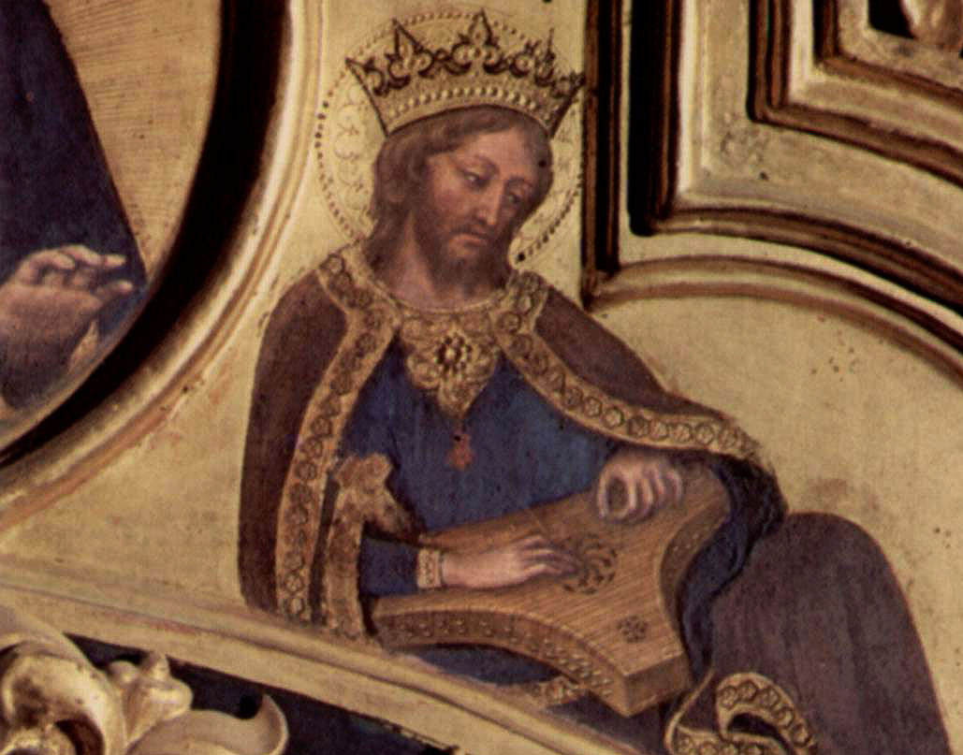
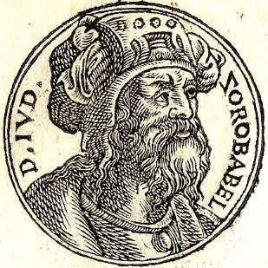
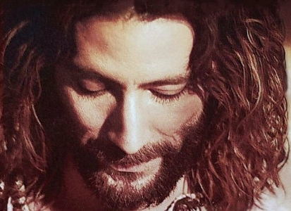
Haggai 2.20-23
King David playing harp
da Fabriano Gentile
vanderbilt.edu
Jesus
The Gospel of John movie
Zerubbabel
Guillaume Rouille Wikipedia.org

Slide 2
Haggai 2.20-23 NET: Then the LORD spoke to Haggai a second time on the twenty-fourth day of the month: “Tell Zerubbabel governor of Judah: ‘I am ready to shake the sky and the earth. I will overthrow royal thrones and shatter the might of earthly kingdoms. I will overthrow chariots and those who ride them, and horses and their riders will fall as people kill one another. On that day,’ says the LORD of Heaven’s Armies, ‘I will take you, Zerubbabel son of Shealtiel, my servant,’ says the LORD, ‘and I will make you like a signet ring, for I have chosen you,’ says the LORD of Heaven’s Armies.”

Slide 3
Haggai 2.23 NET: “‘On that day,’ says the LORD of Heaven’s Armies, ‘I will take you, Zerubbabel son of Shealtiel, my servant,’ says the LORD, ‘and I will make you like a signet ring, for I have chosen you,’ says the LORD of Heaven’s Armies.”

Slide 4
Command
Be God’s Faithful Remnant
Be devoted
Be clean and obedient
Be dependent
Be faithful and trusting
Build the Temple

Slide 5
Promise
New exodus-deliverance
Shake up heavens & earth
Nations to pay tribute to God
Freedom & peace for Jerusalem
New temple will be glorious and have peace

Slide 6
Promise
New exodus-deliverance
Shake up heavens & earth
Shake up heavens & earth
Nations to pay tribute to God
Overthrow might of nations
Freedom & peace for Jerusalem
Zerubbabel servant & signet ring
New temple will be glorious and have peace

Slide 7
2 Samuel 7.8-11 NET: “So now, say this to my servant David, ‘This is what the LORD of Heaven’s Armies has said: I took you from the pasture and from your work as a shepherd to make you leader of my people Israel. I was with you wherever you went, and I defeated all your enemies before you. Now I will make you as famous as the great men of the earth. I will establish a place for my people Israel and settle them there; they will live there and not be disturbed anymore. Violent men will not oppress them again, as they did in the beginning and during the time when I appointed judges to lead my people Israel. Instead, I will give you relief from all your enemies. The LORD declares to you that he himself will build a dynastic house for you.

Slide 8
2 Samuel 7.12-17 NET: When the time comes for you to die, I will raise up your descendant, one of your own sons, to succeed you, and I will establish his kingdom. He will build a house for my name, and I will make his dynasty permanent. I will become his father and he will become my son. When he sins, I will correct him with the rod of men and with wounds inflicted by human beings. But my loyal love will not be removed from him as I removed it from Saul, whom I removed from before you. Your house and your kingdom will stand before me permanently; your dynasty will be permanent.’” Nathan told David all these words that were revealed to him.

Slide 9
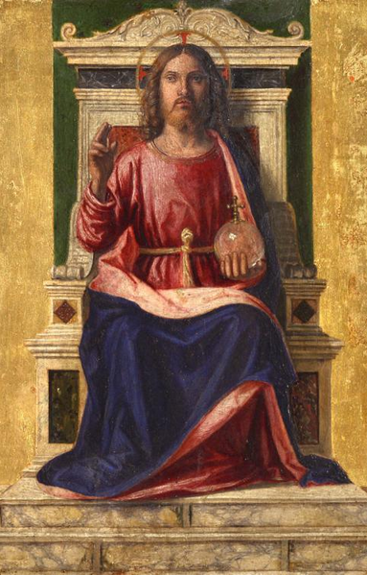
Isaiah 9.7 NET: His dominion will be vast, and he will bring immeasurable prosperity. He will rule on David's throne and over David's kingdom, establishing it and strengthening it by promoting justice and fairness, from this time forward and forevermore. The zeal of the LORD of Heaven’s Armies will accomplish this.
Cima da Conegliano
italian-art.ru

Slide 10
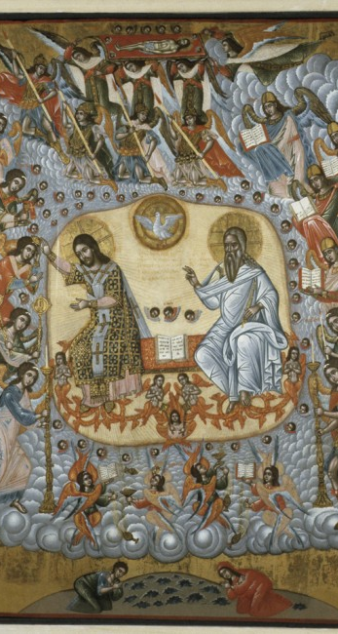
Daniel 7.13-14 ESV: I saw in the night visions, and behold, with the clouds of heaven there came one like a son of man, and he came to the Ancient of Days and was presented before him. And to him was given dominion and glory and a kingdom, that all peoples, nations, and languages should serve him; his dominion is an everlasting dominion, which shall not pass away, and his kingdom one that shall not be destroyed.
University of Notre Dame Medieval Institute

Slide 11
Matthew 21.9 NET: “Hosanna to the Son of David!”
Luke 1.32-33 NET: “He will be great, and will be called the Son of the Most High, and the Lord God will give him the throne of his father David. He will reign over the house of Jacob forever, and his kingdom will never end.”
Isaiah 42.1 NIV: Here is my servant, whom I uphold, my chosen one in whom I delight; I will put my Spirit on him, and he will bring justice to the nations.

Slide 12
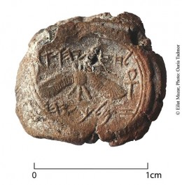
King Hezekiah’s signet ring
© Eilat Mazar / biblicalarchaeology.org

Slide 13
God
King Hezekiah’s signet ring
Israel
King
Nations
© Eilat Mazar / biblicalarchaeology.org

Slide 14
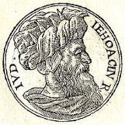
Jeremiah 22.24-23:1 NIV: “As surely as I live,” declares the LORD, “even if you, Jehoiachin son of Jehoiakim, king of Judah, were a signet ring on my right hand, I would still pull you off. I will deliver you into the hands of those who want to kill you, those you fear-- Nebuchadnezzar king of Babylon and the Babylonians. I will hurl you and the mother who gave you birth into another country, where neither of you was born, and there you both will die. You will never come back to the land you long to return to.”
Jehoiachin / Wikipedia.org

Slide 15
Jeremiah 22.24-23:1 NIV continued…
Is this man Jehoiachin a despised, broken pot, an object no one wants? Why will he and his children be hurled out, cast into a land they do not know? O land, land, land, hear the word of the LORD! This is what the LORD says: “Record this man as if childless, a man who will not prosper in his lifetime, for none of his offspring will prosper, none will sit on the throne of David or rule anymore in Judah.”
Jehoiachin / Wikipedia.org

Slide 16
God
Jeremiah 22.24-23:1 NIV:
“As surely as I live,” declares the LORD, “even if you, Jehoiachin son of Jehoiakim, king of Judah, were a signet ring on my right hand, I would still pull you off.”
[Regarding Jehoiachin,] “none of his offspring will prosper, none will sit on the throne of David or rule anymore in Judah.”
Israel
King
Nations

Slide 17
Haggai 2.23 NET: On that day,’ says the LORD who rules over all, ‘I will take you, Zerubbabel son of Shealtiel, my servant,’ says the LORD, ‘and I will make you like a signet ring, for I have chosen you,’ says the LORD who rules over all.”

Slide 18
God
Promises for Deliverance
God will destroy the might of the nations.
God will restore the Davidic Monarchy.
The Messiah-king will set Israel free and bring them lasting peace.
All Powerful God would accomplish all this; the weakness and smallness of the post-exilic community were not an obstacle.
Israel
King
Nations

Slide 19
God
Promises about Christ
The divine Son of God, who came to be the human savior known as the Christ or Messiah, will be God the Father’s king over the Earth.
Already, God the Father has anointed Christ as the king and granted all authority to him.
When Christ returns, he will sit on David’s throne and rule over Israel, and through Israel the world.
Israel
King
Nations

Slide 20
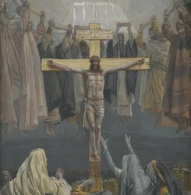
James Tissot / BrooklynMuseum.org

